Slide 1
Data Mining
A presentation prepared by,
Anshu Hada
Section- A

Slide 2
Outlines
What is Data Mining?
Steps of Data Mining
Objectives of Data Mining
Data Mining techniques
Application of Data Mining
Advantages of Data Mining
Challenges on Data Mining
Future of Data Mining
Conclusions

Slide 3
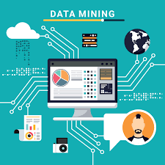
What is Data Mining?
1
Data Mining refers to the process of searching analyzing a large batch of raw data in order to identify pattern and extract useful information.
Data mining relies on effective data collection, warehousing, and computer processing.
Machine Learning (ML), Artificial Intelligence, data management are crucial elements of data mining that are necessary.
Popular data mining tools include R, Python, Weka, and Rapid Miner, each offering unique features and capabilities.

Slide 4
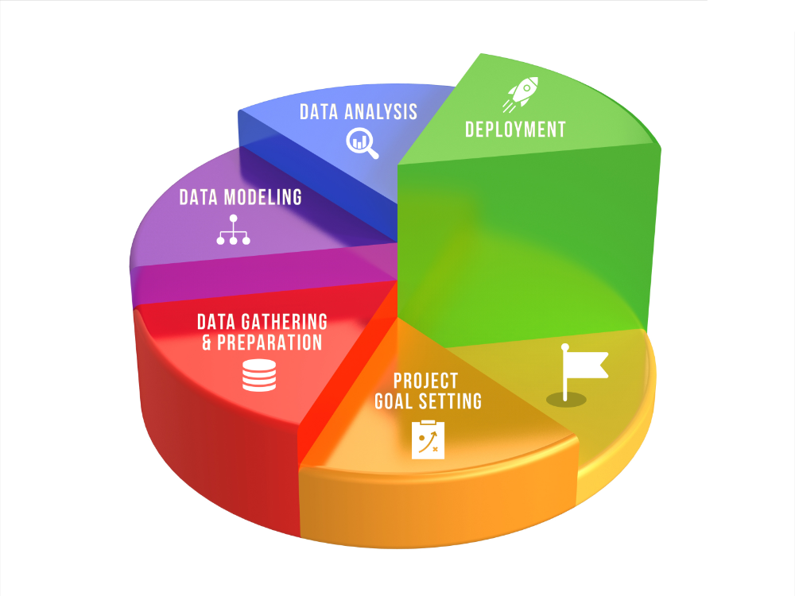
Steps of Data Mining
2
Firstly, Data are collected and loaded into data warehouses on-site or on a cloud service.
The data are accessed by management teams, business analysts and other professionals and determine how they want to organize it.
In data mining, custom application software sorts and organizes the data.
At the end user presents the data in an easy-to-share format, such as a graph or table.

Slide 5

Objectives of Data Mining
3
The objectives of data mining are as follows:
Pattern discovery
Prediction and Forecasting
Anomaly Detection
Segmentation
Improved Decision-Making

Slide 6
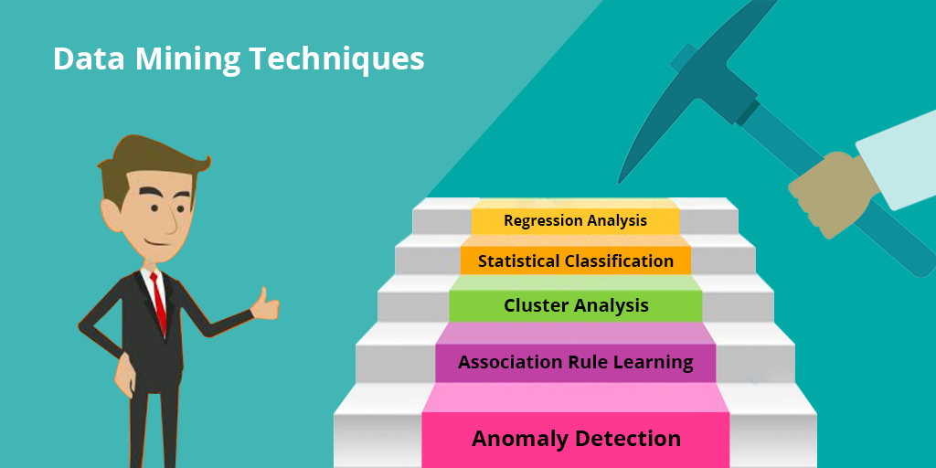
Data Mining Techniques
4
Common data mining techniques are given below:
Classification analysis
Association rule learning
Anomaly detection
Clustering analysis
Regression analysis

Slide 7

Applications of Data Mining
5
Data mining is widely used in various fields . Some of them are given below:
Retail Industry
Telecommunication Industry
Biological Data Analysis
Intrusion Detection

Slide 8
Advantages of Data Mining
6
The advantages of data mining are mentioned below:
Marketing/ Retails
Finance/ Banking
Researchers
Predict future trends
Helps in decision making

Slide 9
Challenges in Data Mining
7
Despite its benefits, data mining has some challenges and they are as follows:
Privacy concerns
Expensive
Technical knowledge
Large database

Slide 10

Future of data mining
8
Data mining has become an important part of technology that is used by many companies and firms to make critical business decisions. Following are some of the trends that are expected in the future of data mining:
Distributed data mining
Multimedia Data mining
Geographic data mining
Time series & sequence data mining

Slide 11
Conclusion
9
In conclusion, Data mining plays a crucial role in extracting valuable insights from data, empowering businesses and decision-makers. Incorporating data mining into the analytical process empowers business analysts with deeper insights into customers behavior patterns, better predictions capabilities for future trends , enhanced risk managements strategies and new opportunities for innovations within an organizations.

Slide 12
Any Queries ?

Slide 13
Thank You!!

